Slide 1


Slide 2

PRESENTATION
BY:
OKERE EMMANUEL EMMANDIBUS

Slide 3
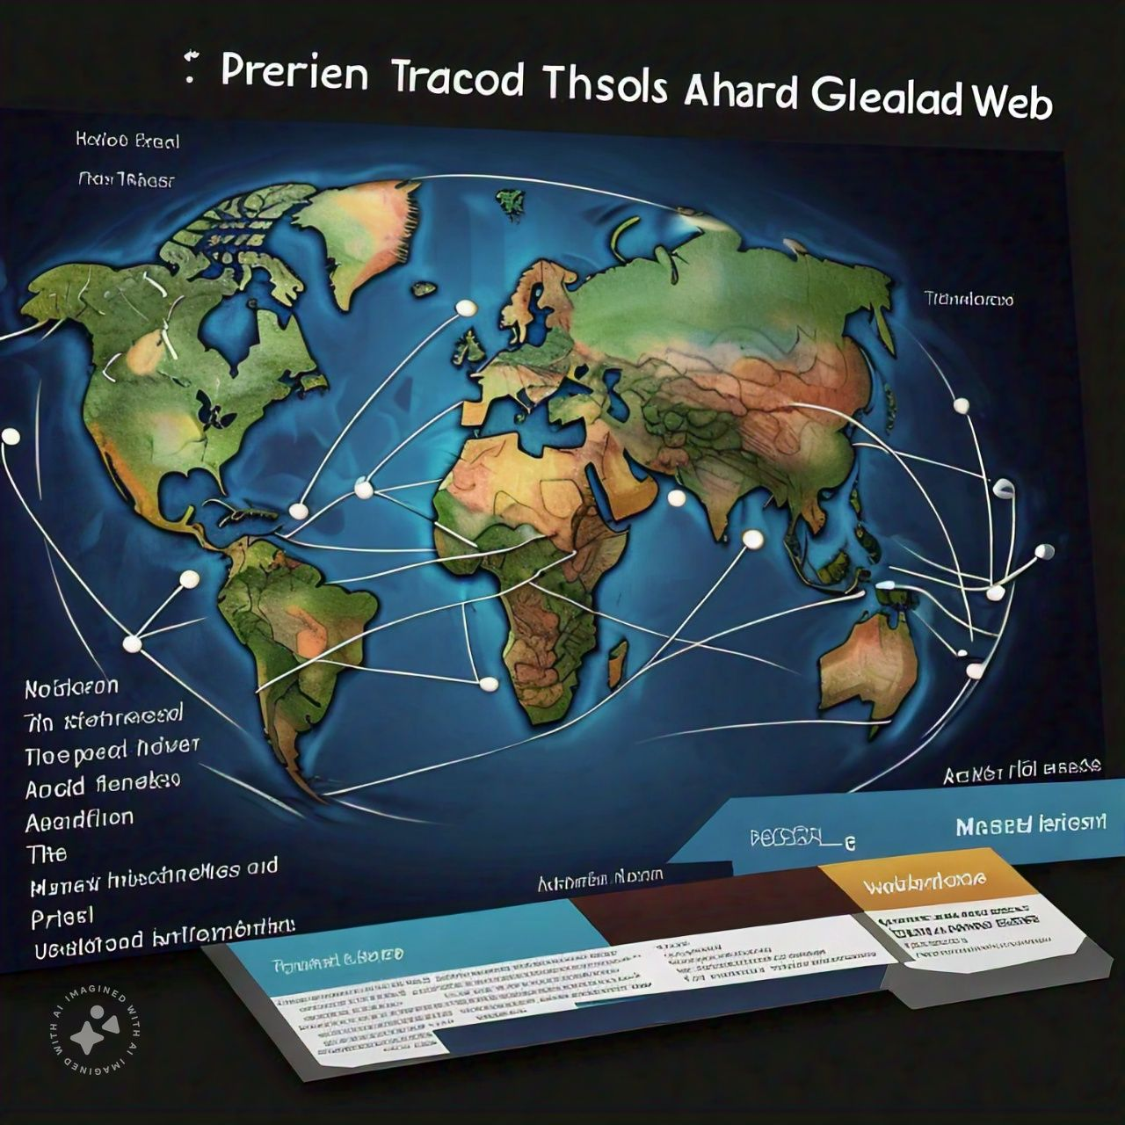
PRESENTS

Slide 4

WORLD WIDE WEB (WWW)

Slide 5
INTRODUCTION

Slide 6
CONTENT:
INTRODUCTION OF WWW
MEANING OF WWW
HISTORY OF WWW
EVOLUTION OF WEB TECHNOLOGIES
WHAT IS INTERNET
BASIS TERMINOLOGIES OF WWW
REQUIREMENTS TO ACCESS WWW
IMPACTS OF WWW TO THE PHYSICAL WORLD
STATISTICS OF THE USEAGE OF THE WEB
FUTURE DEVELOPMENT S TO THE WEB
SOFTWARE FOR WEBSITE DESIGN
REFERENCES

Slide 7
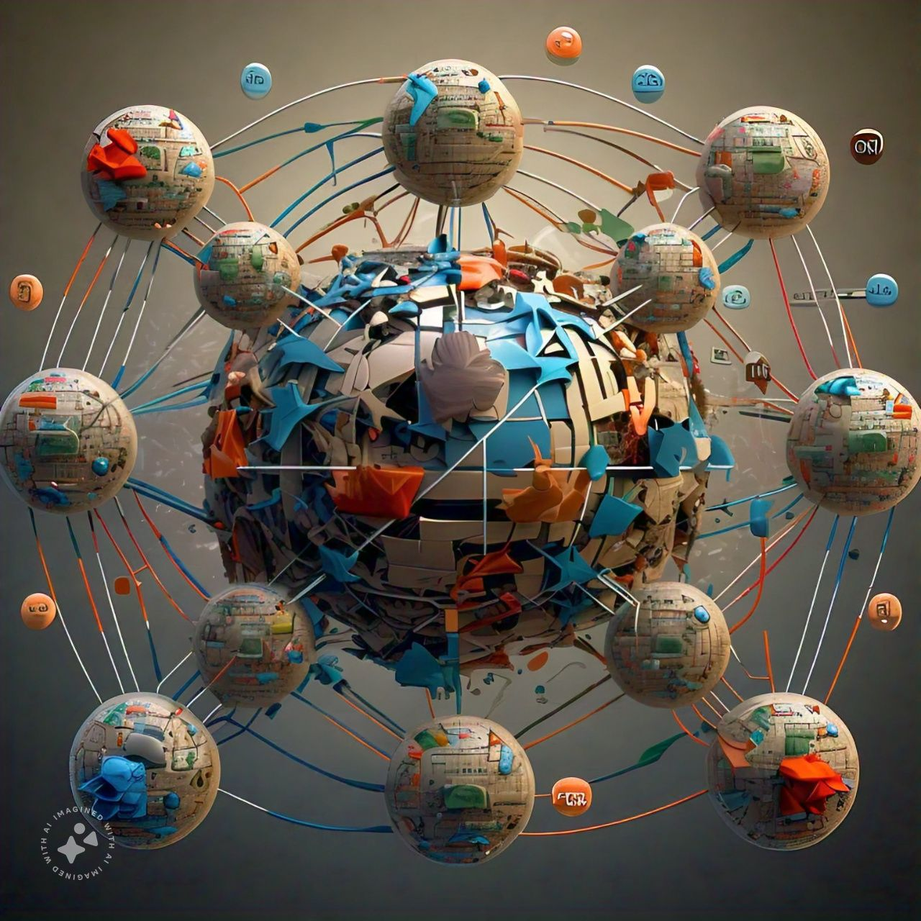
I
INTRODUCTION

Slide 8
WHAT IS WWW?
Definition:
www meaning “world wide web” is the collection of pages of information stored on computers all over the that are linked together by means of hyperlinks.
It can also be seen as part of the internet that contains linked text, image, sounds, videos, and other documents.
Websites on the world wide web have “www” in their address. For example Jovic is on the web at www.jovic.net
A link can be made to another page on the same document or on documents in other computers in any part of the world. The link is usually underlined and once it is clicked. It is clicked, it collects related documents together.

Slide 9

HISTORY OF WWW
1980,
Timoty Berners-lee brought up the idea

Slide 10
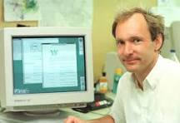
Timoty Berners-Lee

Slide 11
2. 1990: Berners-lee writes the first web browser and server software
3. 1991: the first website is launched.
4. 1993: the world wide web is made available to the public.
5. 1994: Netscape Navigator is released becoming first commercial web browser.
6. 1995: internet explorer is released by Microsoft
7. 1998: Google is founded, revolutionizing search engines.
8. 2000: broadband internet becomes widely available
9. 2004: Facebook is launched, marking the rise of social media
10. 2007: IPhone is released, popularizing mobile internet
11. 2010: cloud computing, big data, and AI emerge.

Slide 12

EVOLUTION OF WEB TECHNOLOGIES

Slide 13
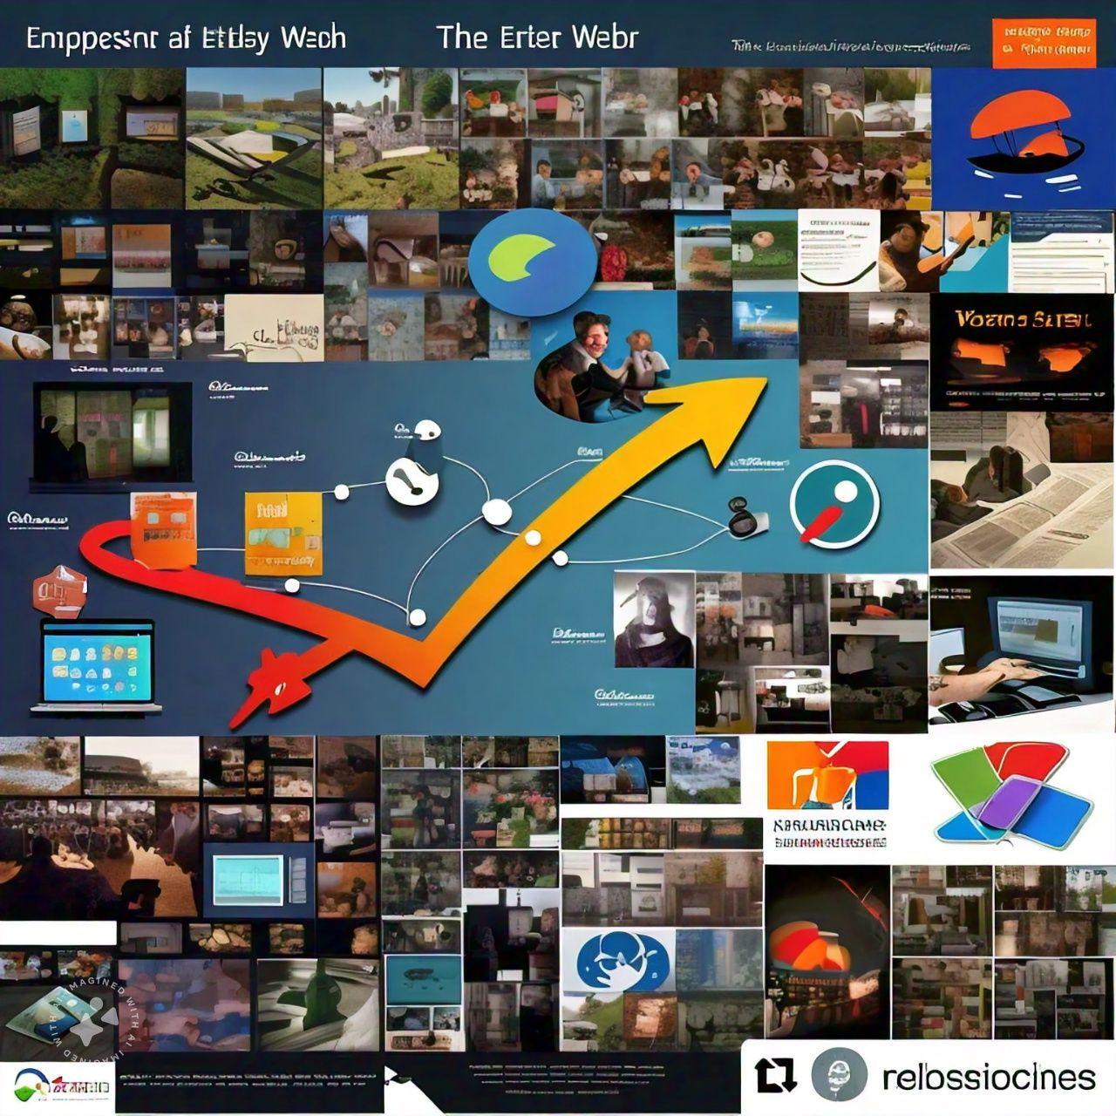

Slide 14
INTERNET
To start with, the full meaning of INTERNET is INTERnational NETwork
Internet, is a world wide “network of networks” it consists of millions of smaller domestic, academic, business and government computer networks, which together carry various information and services such as electronic mail, online chat, file transfer and interlinked web pages and other documents of the world wide web.

Slide 15

HISTORY OF INTERNET

Slide 16


Slide 17
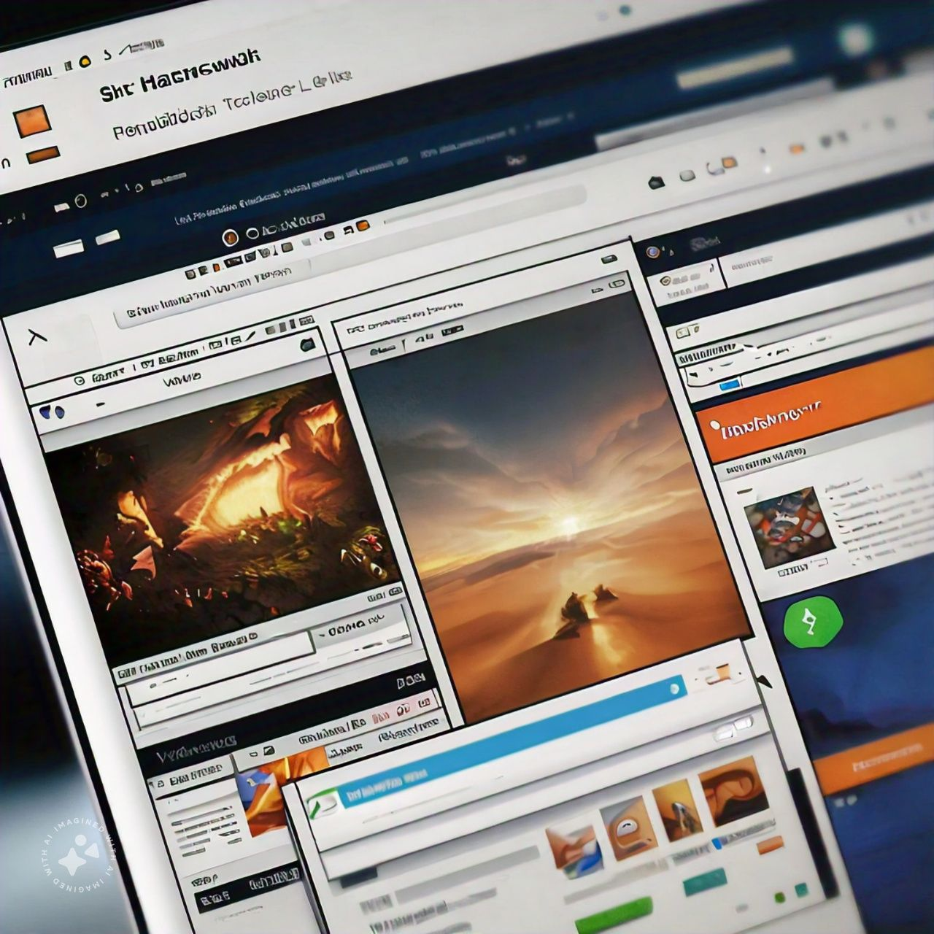


Slide 18
BASIC TERMINOLOGIES ASSOCIATED WITH THE WORLD WIDE WEB
Web browser
Website
Webpage
Home page
Blog
Search engines
Hyperlink
Html
http & https
URL
Web hosting

Slide 19
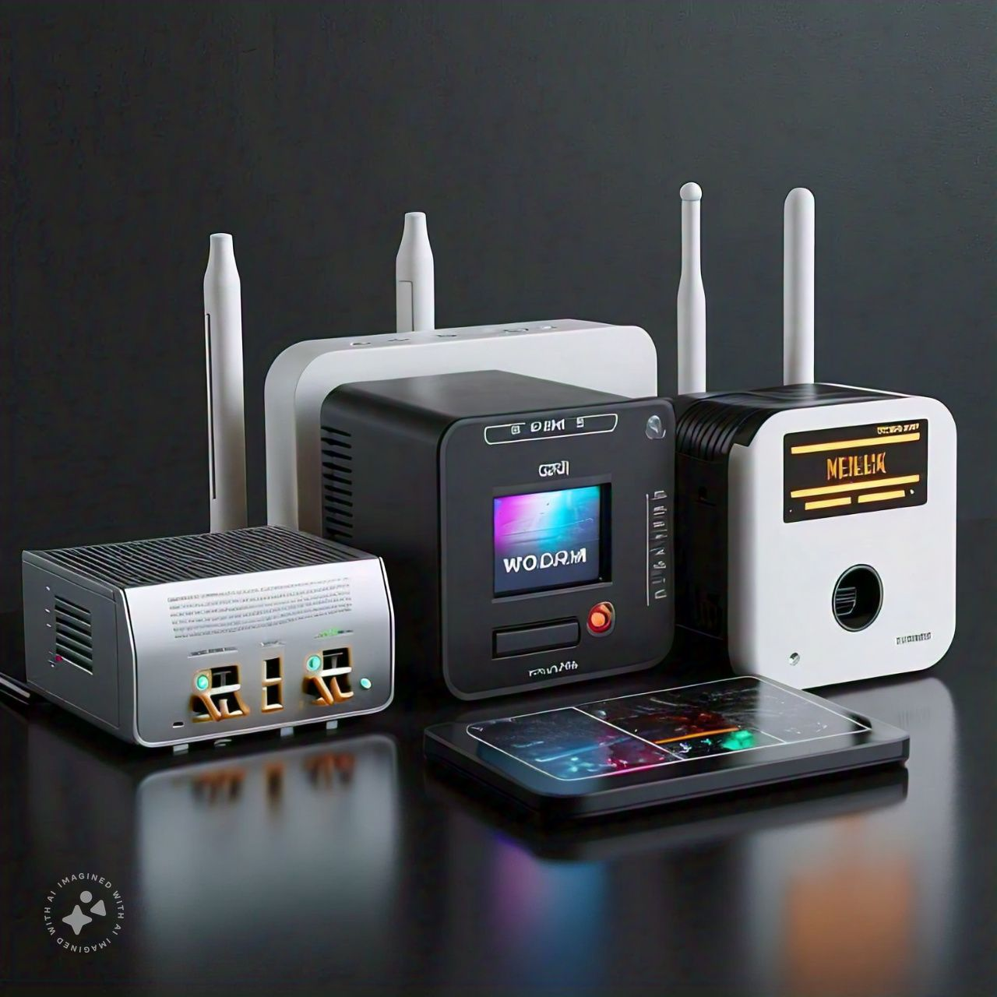
BASIC REQUIREMENTS TO LOG ONTO TO THE WEB
1. COMPUTER, PHONES

Slide 20
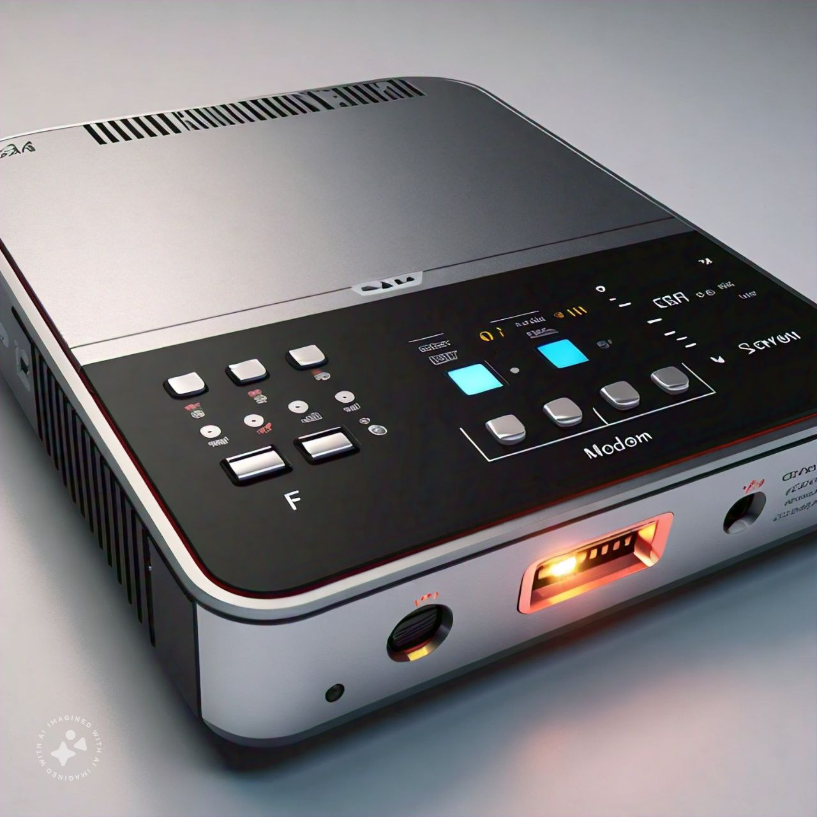
2. MODEM

Slide 21
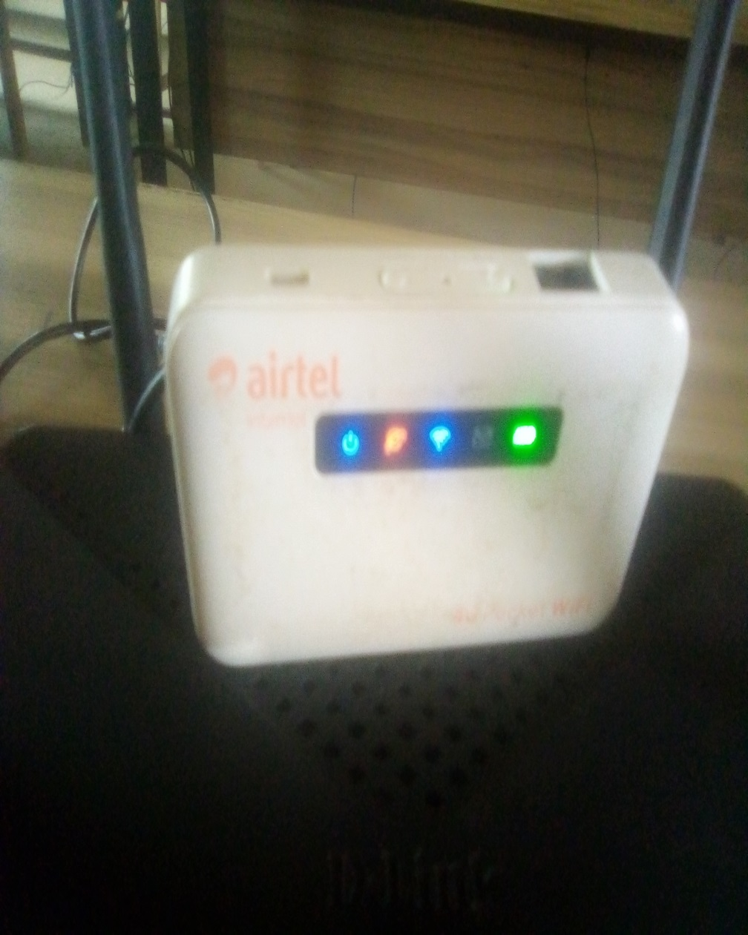
3. Wi-Fi

Slide 22
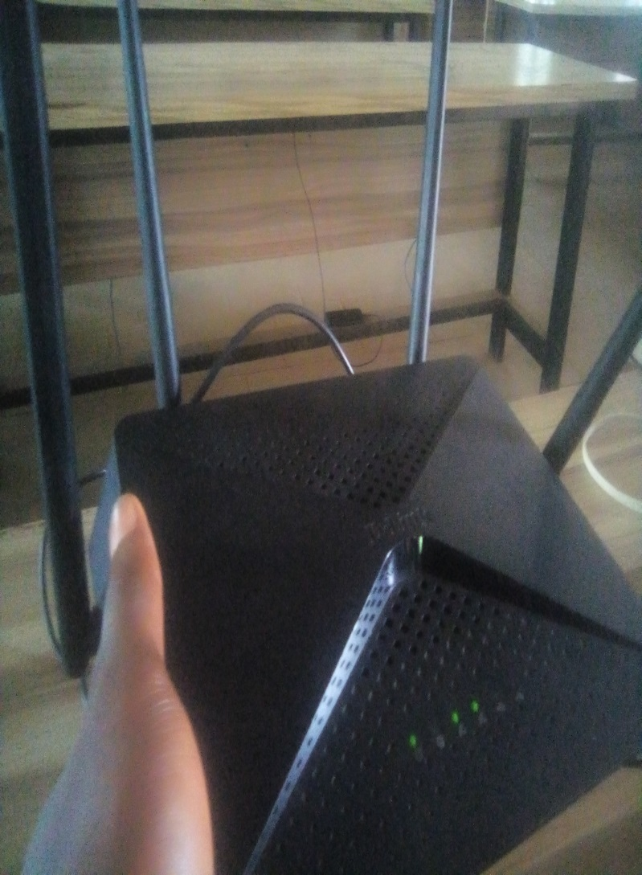
4. ROUTER

Slide 23
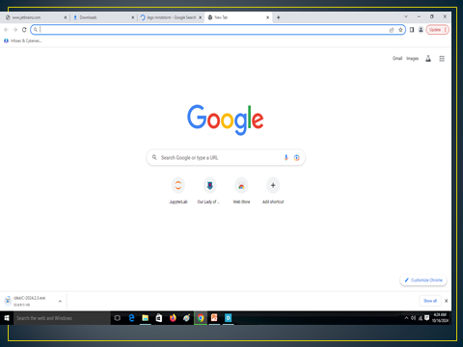

5. APPLICATION SOFTWARE

Slide 24
6. ISP

Slide 25
7. SWITCH

Slide 26
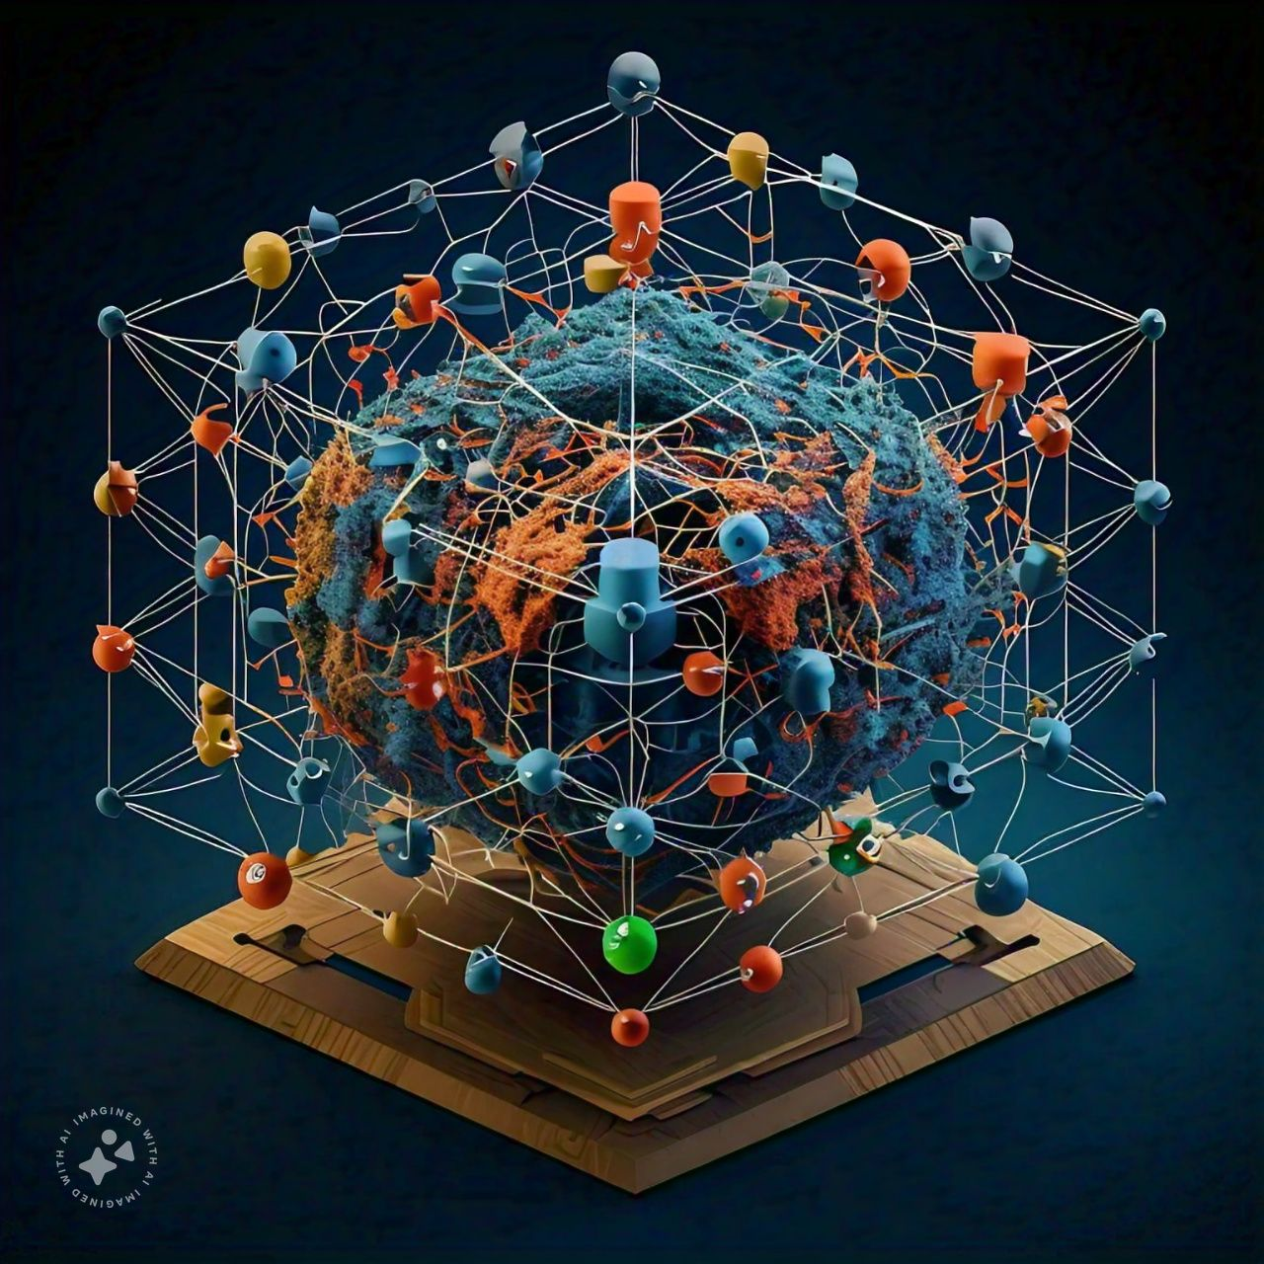
IMPACT OF THE WORLD WIDE WEB TO THE PHYSICAL WORLD

Slide 27
GLOBAL AUDIENCE
AVAILABILITY
RELATIVELY INEXPENSIVE
MULTIMEDIA ACCESS
ENHANCES LEARNING
PROMOTES BUSINESS

Slide 29
ABUSES TO THE WORLD WIDE WEB

Slide 30

1. ADDICTION

Slide 32
PORNOGRAPHY

Slide 33
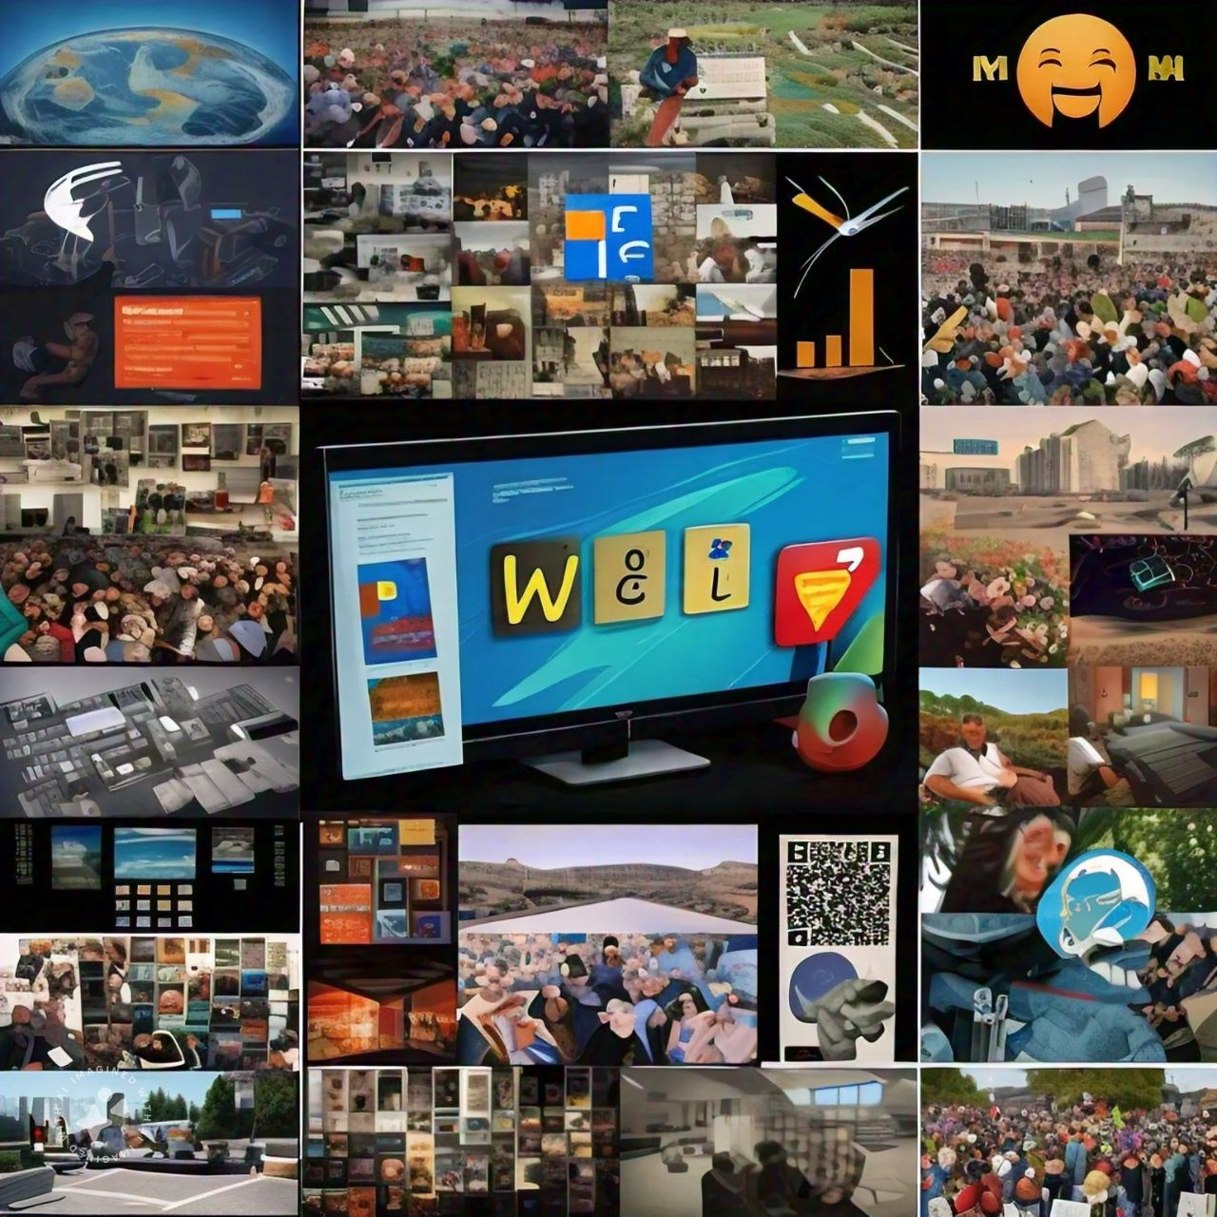

Slide 34
FRAUD
PIRACY
HACKING
PLAGIARISM

Slide 35
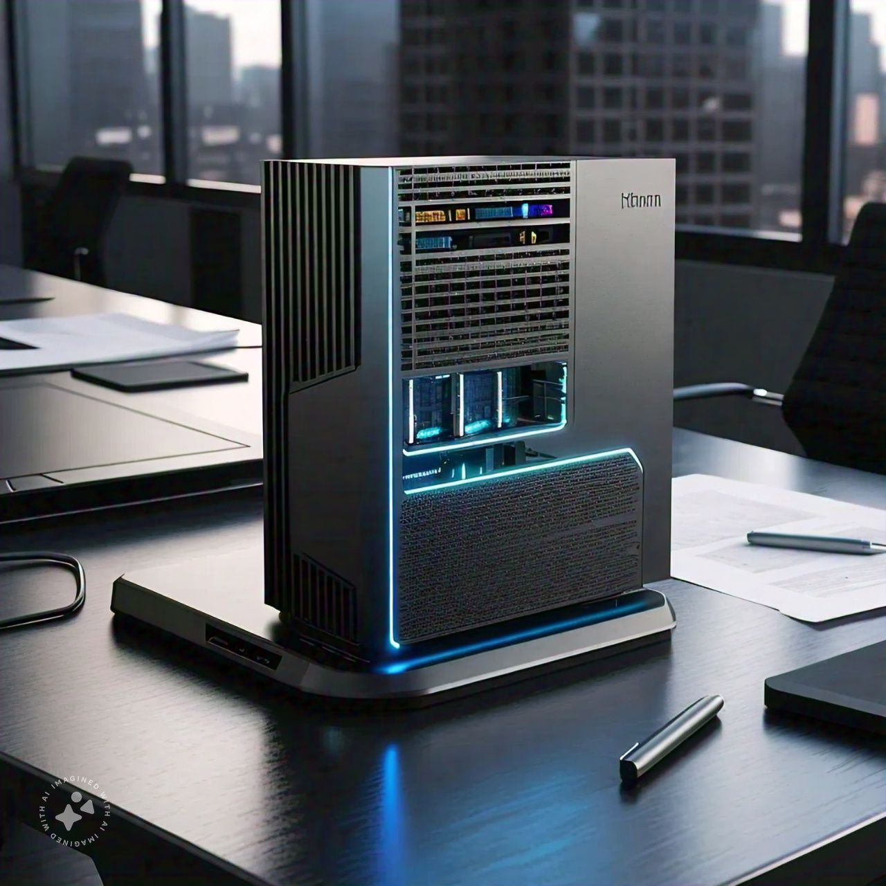

Slide 36
STATISTICS

Slide 37
FUTURE DEVELOPMENTS
INCREASED AI INTEGRATION
IMPROVED CYBERSECURITY
ENHANCED USER EXPERIENCE
EXPANDED INTERNET ACCESSIBILITY
EMERGING TECHNOLOGIES (e.g AR, VR, Blockchain)

Slide 39

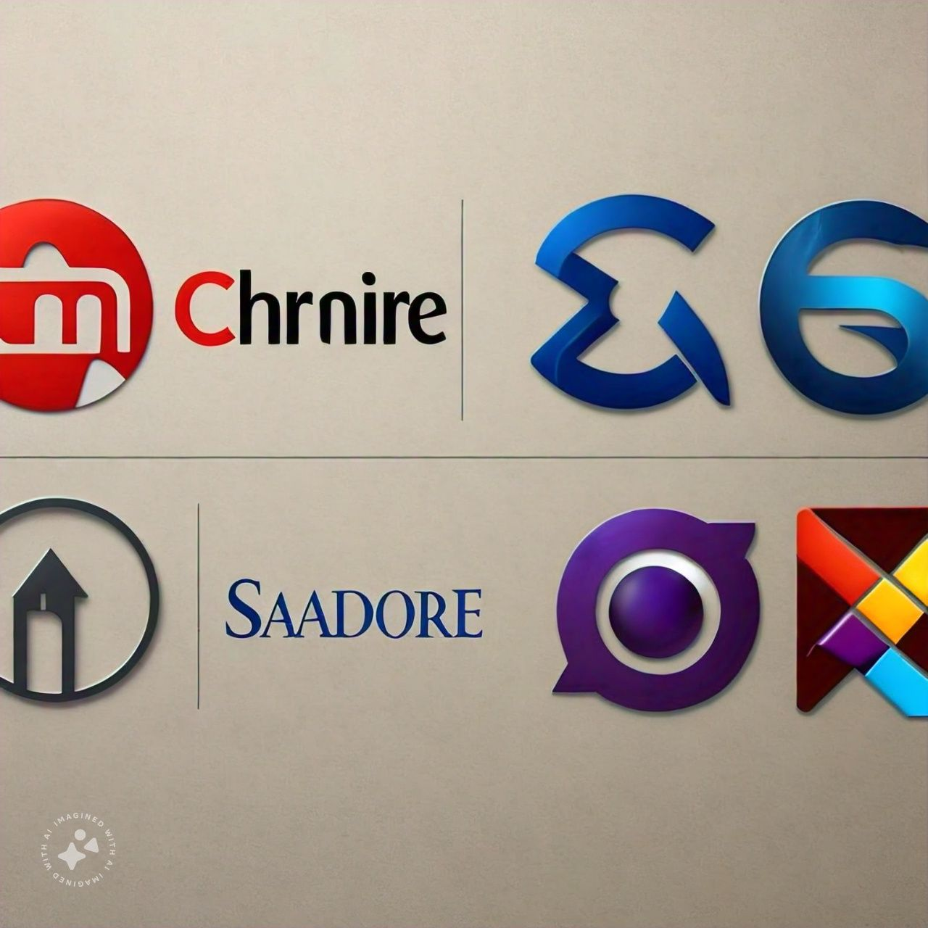
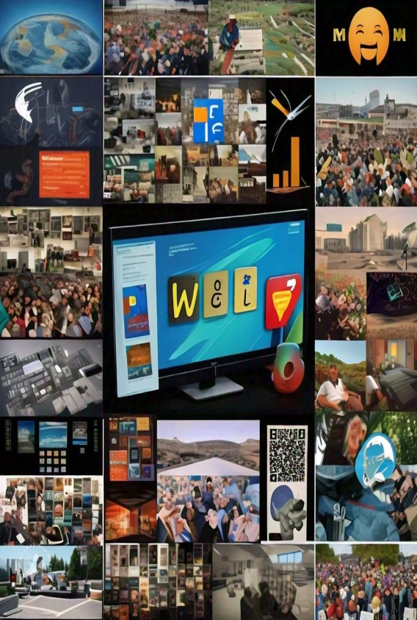

SOFTWARE FOR WEBSITE DESIGN

